Slide 1
Telcom customer churn
SULIMAN ALNASSER

Slide 2
THE PROBLEM IS: We would like to know based on which features the customers are most likely to churn or stay.
https://www.kaggle.com/blastchar/telco-customer-churn/data
BEFOR STARTING WE HAD TO DO SOME CLEANING
EXP:
(changing the type of totalcharges to float and dropping null values, dropping the customer id because we don't need it)

Slide 3
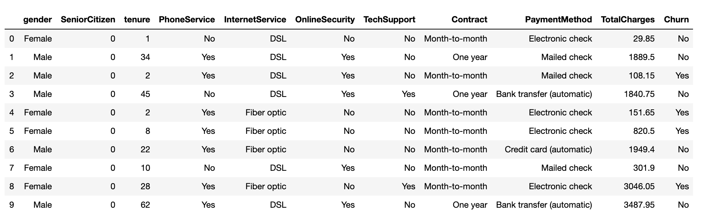
DF sample:

Slide 4
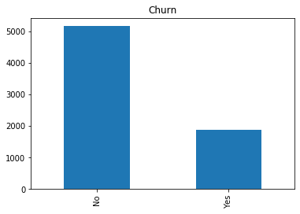
In this dataset of 7032 customers, 26% of them has left in a month. This is critical to business because it is often more expensive to have new customers than to keep existing ones.

Slide 5
THE SUMMARY STATS FOR THE DF COLUMN:
 | tenure | MonthlyCharges | TotalCharges
count | 7032.000000 | 7032.000000 | 7032.000000
mean | 32.421786 | 64.798208 | 2283.300441
std | 24.545260 | 30.085974 | 2266.771362
min | 1.000000 | 18.250000 | 18.800000
25% | 9.000000 | 35.587500 | 401.450000
50% | 29.000000 | 70.350000 | 1397.475000
75% | 55.000000 | 89.862500 | 3794.737500
max | 72.000000 | 118.750000 | 8684.800000

Slide 6
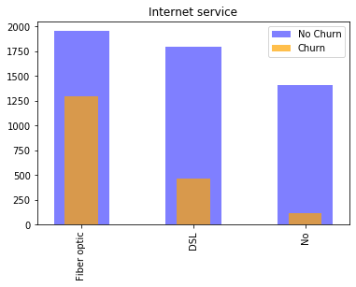
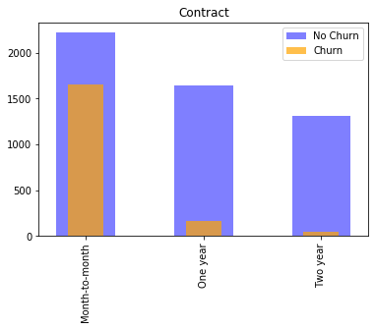
SAMPLE OF PLOTING FEATURE LIKELY TO CHURN OR NOT

Slide 7
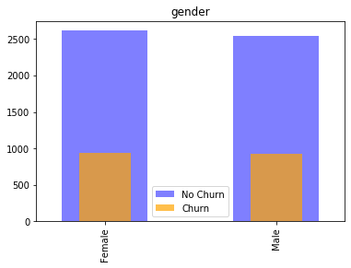
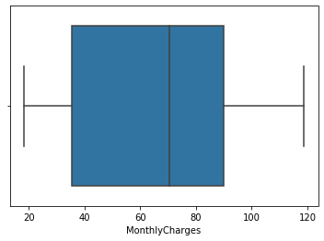
plotting the churn and no churn base on gender.
Plotting The monthly charges range checking for the distribution of the values and the mean.

Slide 8
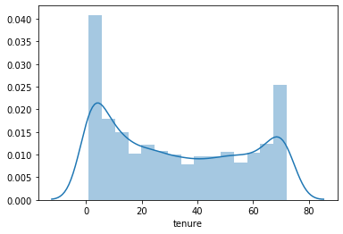
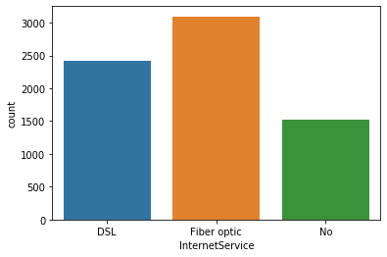
tenure.
The most used in internet service .

Slide 9
THE MODELS RESULT OUT FROM DF:
CONFUSION MATRIX FOR LR [[956 96]
[162 193]]
THE TEST SCORE FOR LR :
0.81
CONFUSION MATRIX FOR RSRF : [[1372 208]
[ 275 255]]
THE TEST SCORE FOR RSRF :
0.77
CONFUSION MATRIX FOR BMRF : [[1279 301]
[ 197 333]]
THE TEST SCORE FOR BMRF :
0.76
CONFUSION MATRIX FOR RF GRS : [[1313 267]
[ 219 311]]
THE TEST SCORE FOR RF GRS :
0.76
BASED ON THE RESULTS WE HAD , WE CHOOSE THE LR AS THE BEST MODEL

Slide 10
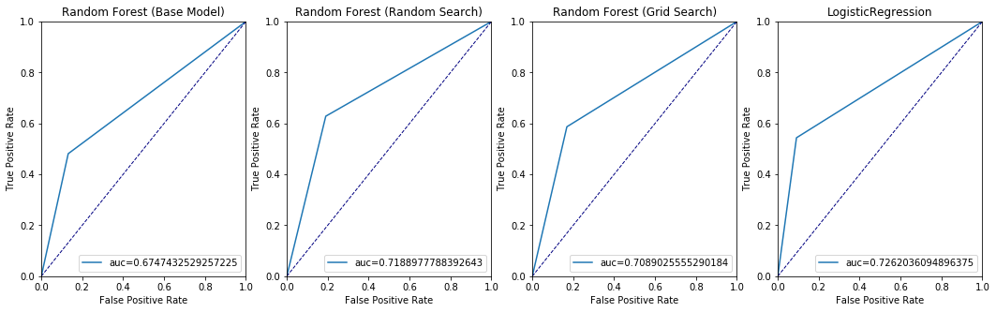
ROC SAMPLE OF THE DF :

Slide 11
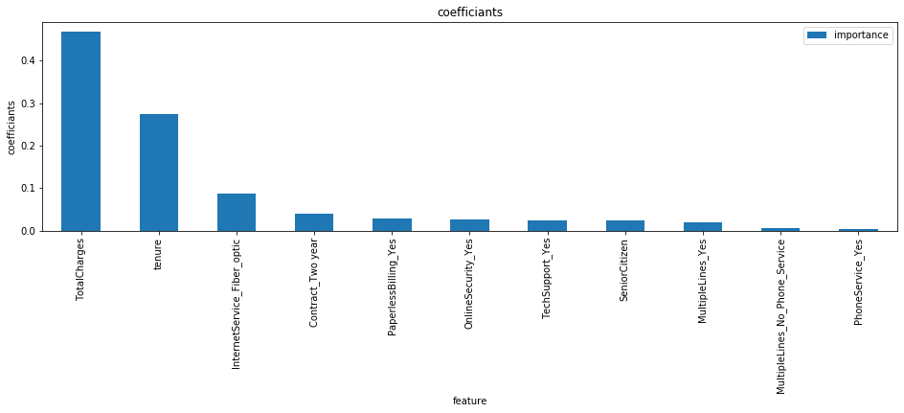
THESE ARE THE MOST IMPORTANCE FEATURES(Random Forest)

Slide 12
HERE ARE THE MOST FEATURE UN\LIKLEY TO CHURN(LogisticRegression):
LIKLEY:
TOTALCHARGES
INTERNETSERVICE_FIBER_OPTIC
STREAMINGMOVIES_YES
0.682476
0.570098
0.176047
UNLIKLEY :
Tenure
CONTRACT_TWO YEAR
TECHSUPPORT_YES
-1.426116
-0.573284
-0.135919

Slide 13
OUR FUTURE PLAN TO GET MORE INFORMATION ABOUT THE REASONS LEAD TO CHURN AND TRY TO GIVE IDEAS TO SOLVE IT..

Slide 14
Thank you..

